Slide 1
A Perspective:
Genomics and Bioinformatics
Matthew L. Settles, Ph.D.
Genome Center
University of California, Davis
settles@ucdavis.edu

Slide 2
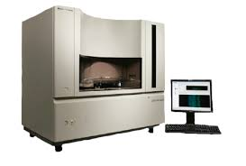
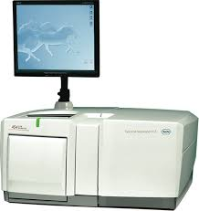
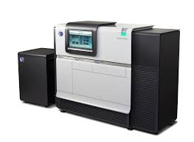
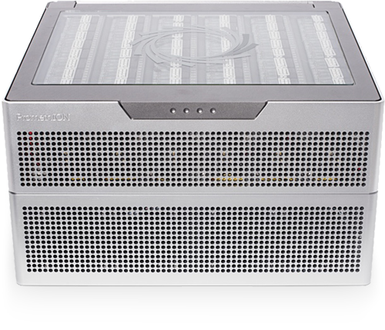
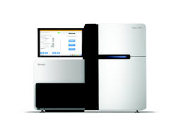
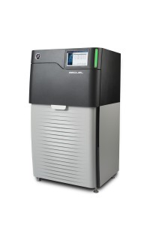
A Brief History

Slide 3
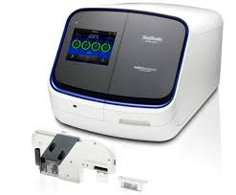
Sequencing Platforms
1986 - Dye terminator Sanger sequencing, peaking at about 900kb/day in early 2000s

Slide 4
‘Next’ Generation
2005 – ‘Next Generation Sequencing’ as Massively parallel sequencing, both throughput and speed advances. The first was the Genome Sequencer (GS) instrument developed by 454 life Sciences (later acquired by Roche), Pyrosequencing 1.5Gb/day
Discontinued

Slide 5
Illumina (Solexa)
2006 – The second ‘Next Generation Sequencing’ platform. Now the dominant platform with 75% market share of sequencer and and estimated >90% of all bases sequenced are from an Illumina machine, Sequencing by Synthesis > 1600Gb/day.
NovaSeq
HiSeq

Slide 6
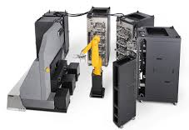
Complete Genomics
2006 – Using DNA nanoball sequencing, has been a leader in Human genome resequencing, having sequenced over 20,000 genomes to date. In 2013 purchased by BGI and is now set to release their first commercial sequencer, the Revolocity. Throughput on par with HiSeq
DEFUNCT
Human genome/exomes only.
10,000 Human Genomes per year

Slide 7
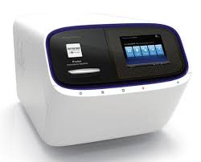
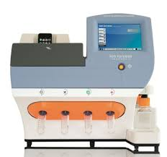
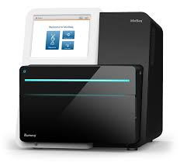
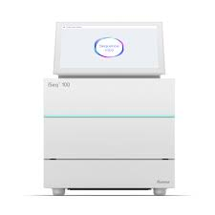
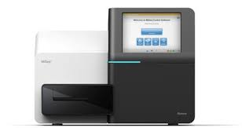
Bench top Sequencers
Life Technologies
Ion Torrent
Ion Proton
Gene Studio S5
Illumina
MiSeq
MiniSeq
iSeq 100

Slide 8
The ‘Next, Next’ Generation Sequencers (3rd Generation)
2009 – Single Molecule Read Time sequencing by Pacific Biosystems, most successful third generation sequencing platforms, RSII ~2Gb/day, newer Pac Bio Sequel ~14Gb/day, near 100Kb reads.
SMRT Sequencing
Iso-seq on Pac Bio possible, transcriptome without ‘assembly’

Slide 9
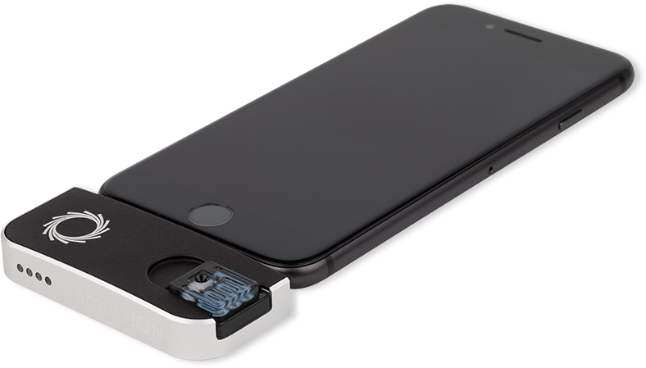
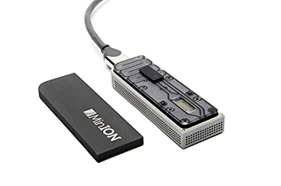
Oxford Nanopore
SmidgION: nanopore sensing for use with mobile devices
2015 – Another 3rd generation sequencer, founded in 2005 and currently in beta testing. The sequencer uses nanopore technology developed in the 90’s to sequence single molecules. Throughput is about 500Mb per flowcell, capable of near 200kb reads.
Fun to play with but results are highly variable
Nanopore Sequencing
FYI: 4th generation sequencing is being described as In-situ sequencing

Slide 10
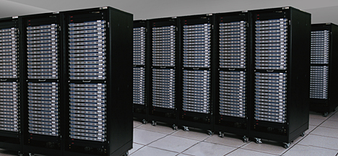
Bioinformatics
Old Way of thinking about Bioinformatics
Appro Cluster

Slide 11
Sequencing Costs
May 2020
$0.008/Mb
$702 per Human sized (30x) genome
Illumina HiSeq 2000
First ‘NGS’ Sequencers
Illumina
X10
Illumina
Novaseq
Includes: labor, administration, management, utilities, reagents, consumables, instruments (amortized over 3 years), informatics related to sequence productions, submission, indirect costs.
http://www.genome.gov/sequencingcosts/

Slide 12
Growth in Public Sequence Database
WGS > 7 trillion bp
> 40 quadrillion bp
http://www.ncbi.nlm.nih.gov/genbank/statistics
http://www.ncbi.nlm.nih.gov/Traces/sra/

Slide 13
Illumina’s Flexibility
Single Multiplexing
Genomic reduction allows for greater coverage and multiplexing of samples.
You can fine tune your depth of coverage needs and sample size
with the reduction technique
1X
Whole Genome
RNA
Reduction Techniques
Capture Techniques
RADseq/GBS
Depth of Coverage
Access Array
Amplicons
Few or Single Amplicons
1KB
100000X
Read 2 primer
Greater Multiplexing
Read 2 (50-300bp)
DNA Sequence
Read 1 (50- 300bp)
Barcode (8bp)
Barcode Read primer

Slide 14
Sequencing Libraries:
DNA-seq
RNA-seq
Amplicons
CHiP-seq
MeDiP-seq
RAD-seq
ddRAD-seq
DNase-seq
ATAC-seq
MNase-seq
FAIRE-seq
Ribose-seq
smRNA-seq
tagRNA-seq
PAT-seq
Structure-seq
MPE-seq
STARR-seq
Mod-seq
EnD-seq
Pool-seq
G&T-seq
Tn-Seq
BrAD-seq
SLAF-seq
MLA-seq is my favorite seq

Slide 15
For all you seq

Slide 16
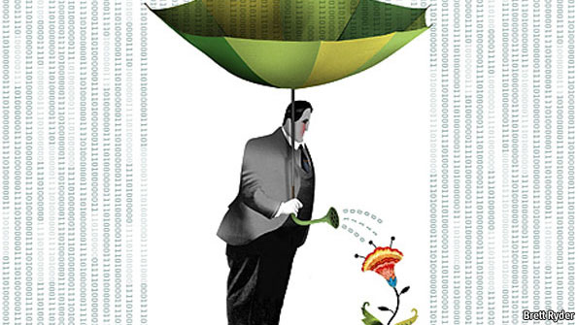
The data deluge
Plucking the biology from the Noise

Slide 17
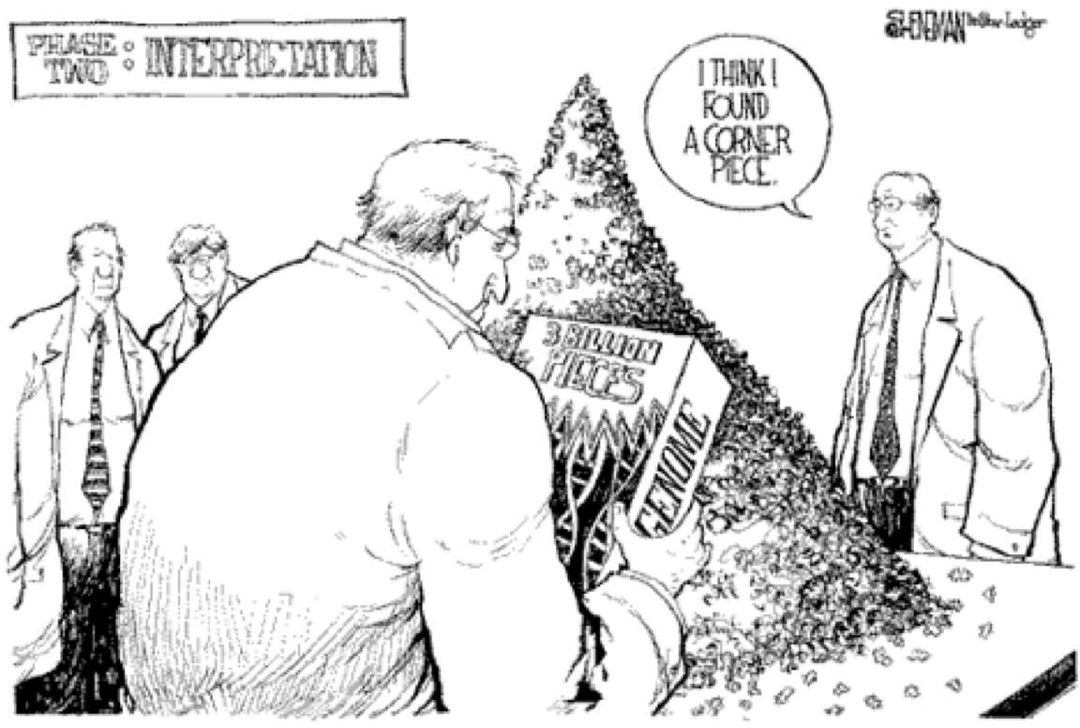
Reality
Its much more difficult than we may first think

Slide 18
Genomics and Bioinformatics
Following data science principles, 2 stages in analysis of genomics data (Bioinformatics)
Data reduction
Sequence data (raw data) to summarized form.
* Command line, shell scripting, and programming. * Requires an understanding of the technology, molecular biology.
* Removing technical noise from data.
Data analysis
Summarized data to biological interpretation
* R/Python statistical programming
* Requires an understanding of the biological question, statistics.

Slide 19
Prerequisites for doing Bioinformatics
Access to a multi-core (24 cpu or greater), ‘high’ memory 64Gb or greater Linux server.
Familiarity with the ’command line’ and at least one programming language.
Basic knowledge of how to install software
Basic knowledge of R (or equivalent) and statistical programming
Basic knowledge of Statistics and model building

Slide 20
Training - Models
Workshops
Often enrolled too late
Collaborations
More experience persons
Apprenticeships
Previous lab personnel to young personnel
Formal Education
Most programs are graduate level
Few Undergraduate

Slide 21
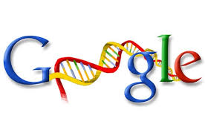

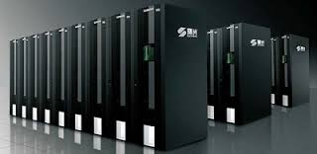
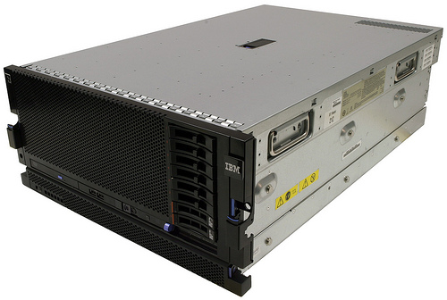
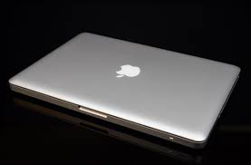
Substrate
Cloud
Computing
Cluster
Computing
LINUX
BASTM
Laptop & Desktop

Slide 22








Environment
“Command Line” and “Programming Languages”
VS
Bioinformatics Software Suite

Slide 23
Data Science
Data science is the process of formulating a quantitative question that can be answered with data, collecting and cleaning the data, analyzing the data, and communicating the answer to the question to a relevant audience.
Five Fundamental Concepts of Data Science
statisticsviews.com November 11, 2013 by Kirk Borne
Notes:
Kirk Borne – George Mason University

Slide 24


Bioinformatician as a Data Scientist
Computational Biology
Biology
Genomics
Math
Statistics
Computer
Science
Biostatistics
Bioinformatics
‘The data scientist role has been described as “part analyst, part artist.”’
Anjul Bhambhri, vice president of big data products at IBM
Notes:
Big data is an evolving term that describes any voluminous amount of structured, semi-structured and unstructured data that has the potential to be mined for information.
The Cloud is just a rebranding of

Slide 25
7 Stages to Data Science
Define the question of interest
Get the data
Clean the data
Explore the data
Fit statistical models
Communicate the results
Make your analysis reproducible

Slide 26
Define the question of interest
Begin with the end in mind!
what is the question
how are we to know we are successful
what are our expectations
dictates
the data that should be collected
the features being analyzed
which algorithms should be use

Slide 27
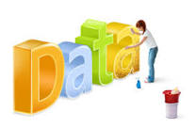
Get the data
Clean the data
Explore the data
Know your data!
know what the source was
technical processing in producing data (bias, artifacts, etc.)
“Data Profiling”
Data are never perfect but love your data anyway!
the collection of massive data sets often leads to unusual , surprising, unexpected and even outrageous.

Slide 28
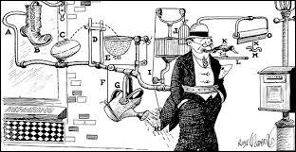
Fit statistical models
Machine Learning
Over fitting is a sin against data science!
Model’s should not be over-complicated
If the data scientist has done their job correctly the statistical models don't need to be incredibly complicated to identify important relationships
In fact, if a complicated statistical model seems necessary, it often means that you don't have the right data to answer the question you really want to answer.

Slide 29
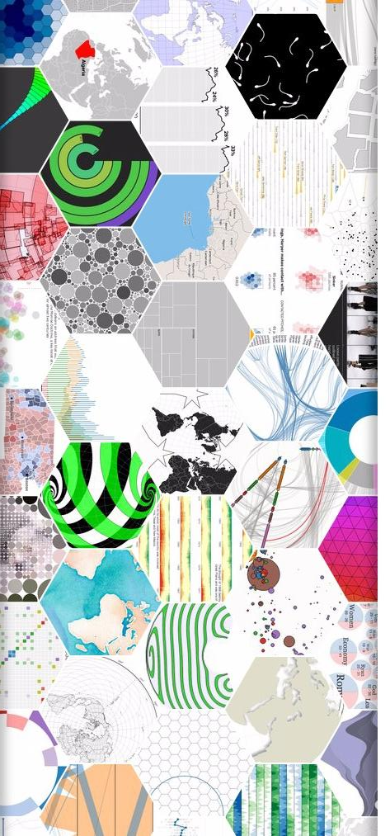
Communicate the results
Make your analysis reproducible
Remember that this is ‘science’!
We are experimenting with data selections, processing, algorithms, ensembles of algorithms, measurements, models. At some point these must all be tested for validity and applicability to the problem you are trying to solve.

Slide 30
Data science done well looks easy – and that’s a big problem for data scientists
simplystatistics.org
March 3, 2015 by Jeff Leek
Bad data science (bioinformatics) also looks easy

Slide 31
The Data Science in Bioinformatics
Bioinformatics is not something you are taught,
it’s a way of life
“The best bioinformaticians I know are problem solvers – they start the day not knowing something, and they enjoy finding out (themselves) how to do it. It’s a great skill to have, but for most, it’s not even a skill – it’s a passion, it’s a way of life, it’s a thrill. It’s what these people would do at the weekend (if their families let them).”
Mick Watson – Rosland Institute
Notes:
How-To: Workshops are by and large unaffected

Slide 32
Types of Data Scientists/Bioinformatician
The Legends: These are the jack-of-all-trades, understands the complete workflow, domain/technology/computational/statistical
The Generalists. Toned down legend
The Statisticians. Focus on Stats, may not know as much about technology or computing
The Dabblers. Focus on Biology, limited on technology/stats can run other peoples code
The Engineers. Algorithm developer, highly computational focus on one area
The Vertical Experts. Like the Generalist/Legend but for only one area and aren’t able to generalize.
https://blog.dataiku.com/the-different-types-of-data-scientists-and-what-kind-you-should-hire

Slide 33
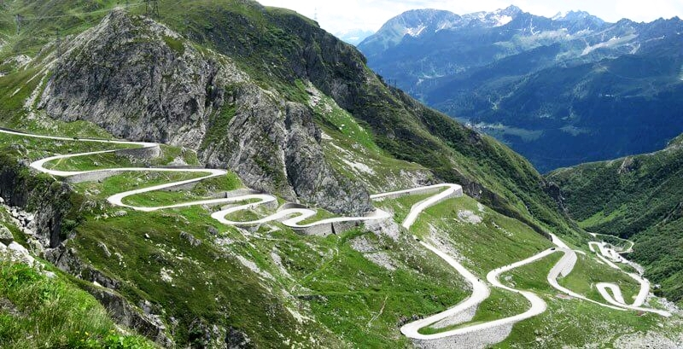
The last mile
http://www.bikeblanket.com/blog/suisse

Slide 34
“The real cost of sequencing”
Sboner et al. Genome Biology 2011 12:125 doi:10.1186/gb-2011-12-8-125

Slide 35
The Bottom Line: In Genomics
Spend the time (and money) planning and producing good quality, accurate and sufficient data.
Get to know to the data, develop and test expectations, explore and identify patterns.
Result, spend much less time (and less money) extracting biological significance and results with fewer failures and reproducible research.

